Slide 1


ANH HUYNH
ANUSHA DATTA
SHENGJING ZHANG
YEW ONN KHAW
Notes:
Hi everyone. I’m Anusha, and today me and my team mates (Anh, Shengjing, Yew Onn) are here to present to you our creation FeedOn.
So what is FeedOn and what does it do? Let’s take a dive into the product overview.

Slide 2
PRODUCT OVERVIEW
FeedOn is a web application serves as a dual platform for F&Bs and charities to connect with one another.
It aims to minimize food wastage by redistributing excess food from F&Bs to charities.
F&Bs
DISPARITY IN FOOD QUANTITY
CHARITIES
Notes:
FeedOn is basically a web application that serves as a dual platform for F&Bs and charities to connect with one another. Our team collectively recognised the disparity in food quantities between F&Bs and Charities. So we decided to use this fact to build a platform that minimizes food wastage by redistributing excess food from F&Bs to charities.

Slide 3
MOTIVATION
Significant motivations include:
Minimising high food wastage
Eradication of hunger
Ensuring food security
These goals are achievable without generating extra food!
Notes:
Now that we know what FeedOn does, let’s take at our primary motivations to take up this project.
As we know, our world is battling high food wastage, widespread hunger and extensive food insecurity. These are all problems that directly affect the basic quality of life. Moreover, higher food wastage also means that we would need to build more waste disposal facilities, which leads to an unnecessary increase energy consumption.
However, by distributing these food leftovers to people who are unable to afford food on their own, we can alleviate their standard of living. So the value of this product is the possibility of solving all the mentioned problems, without even increasing the food output.
And this is exactly what we aim to do, by solely focusing on improving the re-distribution of excess food.
Now over to Anh, who’ll walk you through our target user groups.

Slide 4
USER GROUPS
Dual user application
Food & Beverage organisations
For example: hawker stalls, restaurants, food caterers, bakeries
Charities that provide food
Assuming needy people contacted directly by charities.
Notes:
The product has two main user groups:
Companies in the food and beverage industry. These include hawker stalls, restaurants, food caterers (e.g. in school halls), bakeries, etc. Also includes companies that distribute packet food (biscuits), and anyone working with large volumes of edible but rejected food can create donations in the app
Charities that provide food in Singapore who will immediately receive alerts about food donations and contact the source for delivery arrangements
Note that this website would not be interacting directly with the hungry people. We assume that the charities would be contacting them instead. However, we might add on an additional feature where notifications could be sent to the hungry people on behalf of the charities if time permits.

Slide 5
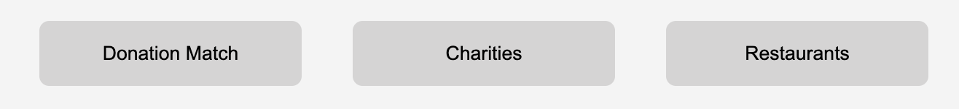
FEATURES: Main Page
Lists all the past collaborations between restaurants and charities.
Lists all the charities registered with FeedOn.
Lists all the restaurants registered with FeedOn.
Notes:
Main page is a place for restaurants and charities to discover each other within their local community and see all interactions happening among them. There are three main tabs on the main pages:
First tab shows all successful collaborations between restaurants and charities in the past, to enhance transparency and encourage further collaboration in the future
Next two tabs are charities and restaurants, which is an easy and convenient way to look through listings or search for contacts on the platform.

Slide 6
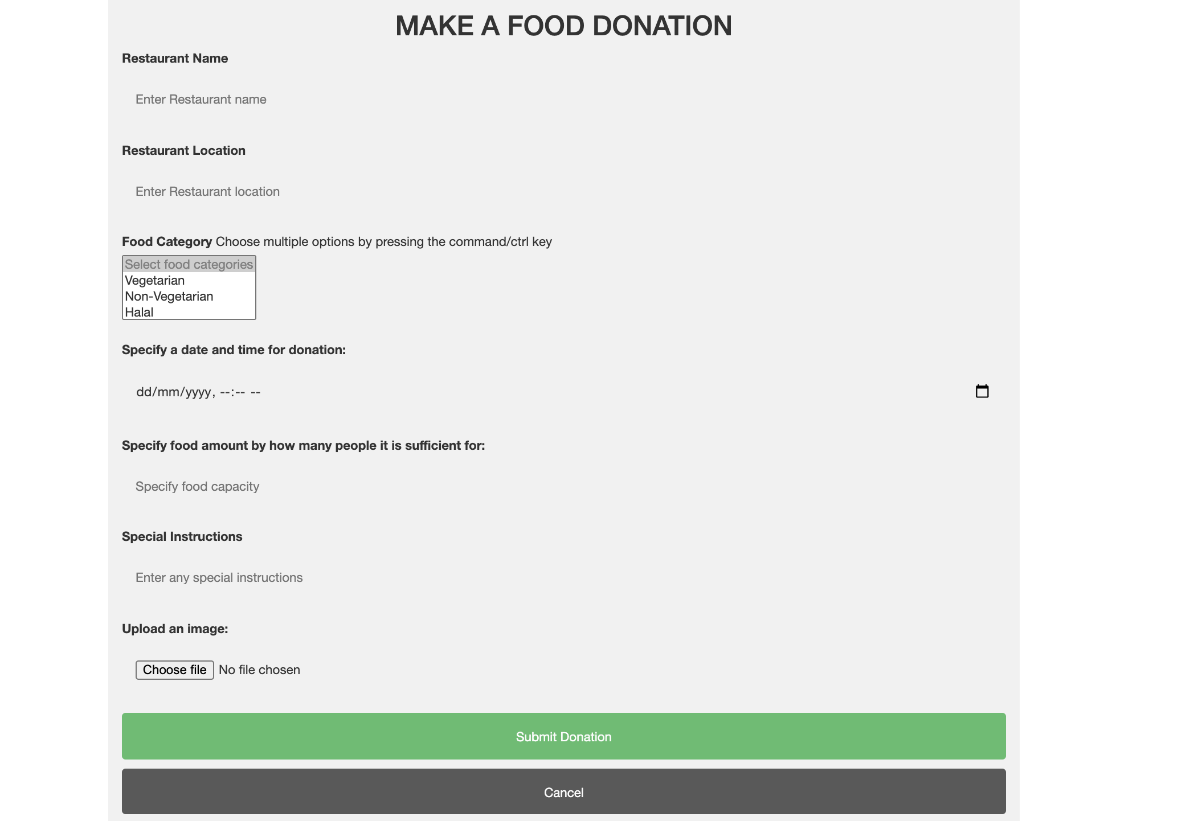
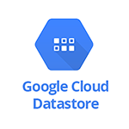
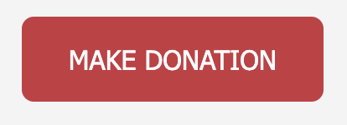


FEATURES: Donation Form
Restaurant
Charity
Notes:
Restaurants can provide detailed information on their donations by filling in a donation form. Restaurant name, location, food category, pick-up time and food amount are required information. Special instructions and uploading an image are optional. After submission, these information will be presented in the charities’ inbox, so that charities can better decide which donation they want to accept. Hungry people can use it to find food that suit their taste.

Slide 7
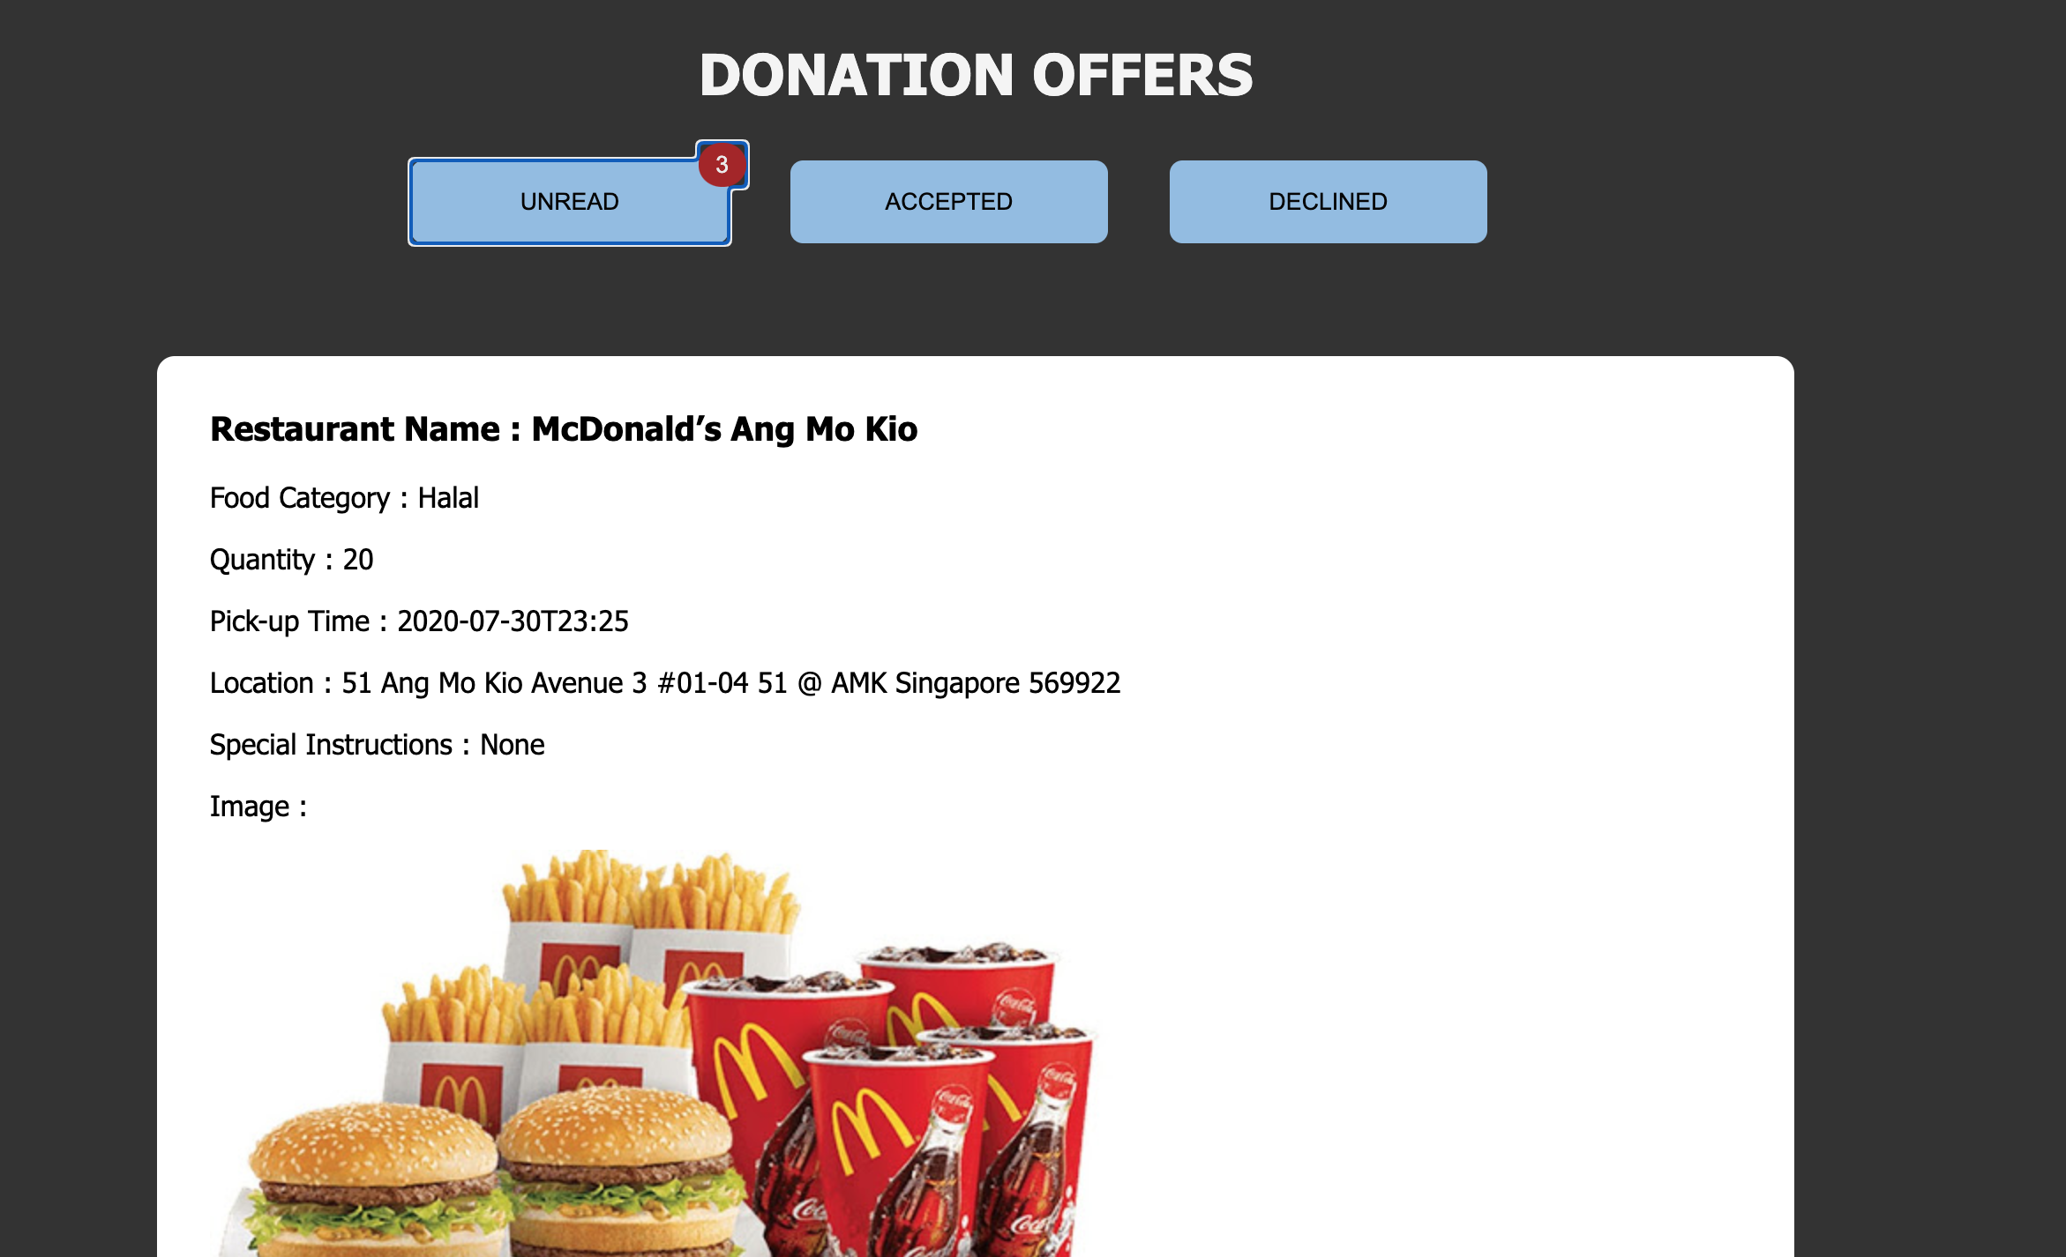
FEATURES: Donation Inbox
Unread
Accepted
Declined
Notes:
As we have mentioned before, each charity has an inbox to store their unread, accepted and declined donations. For unread donations, charities can choose to accept or decline it and then it will be removed from the unread tab.
If the charity accepts one donation, that donation will be displayed on the accepted tab and also on the main page. In the meantime, it will be deleted from other charities’ inbox.
If the charity declines one donation, that donation will be displayed on the declined tab. Other charities can still view it on their own accounts.

Slide 8
LIVE WALKTHROUGH
Register
Create Donation Offer
Accept Donation Offer through Inbox
View updated Feed

Slide 9
Thank you!
-
Q&A

